Slide 1
Classification contest 2024/5
Giving by:
Elyasaf Kopel - 208791996
Shachar Ketz – 208968362
Chanan Helman – 209324102

Slide 2
Data exploration
Most of the data exploration was manually and by few graph mostly to understand the values of the data (for example columns that most or all of the parameters are 0)
Some of this was by showing graphs that showing the features values distribution.
In the feature selection non-important features that don’t have a lot of contribution will be thrown any way.

Slide 3
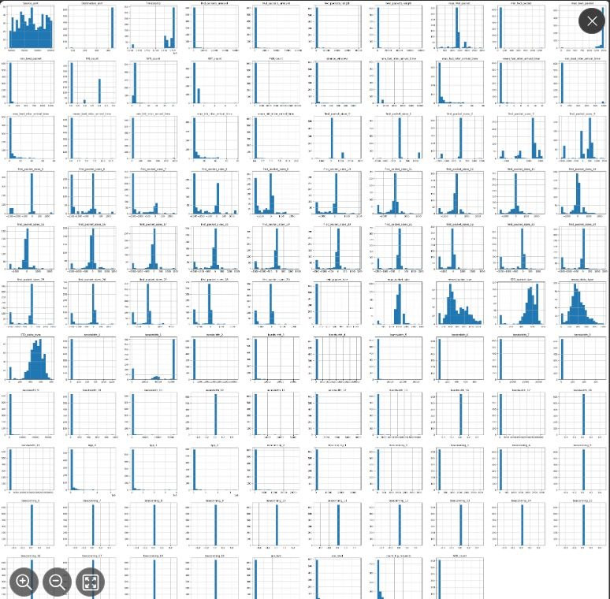
Data exploration

Slide 4
APP classification – previous attempts
There were a lot of attempts for the classification. Here are previous attempts of feature selection and training that had most accuracy.
1) Taking top important features that RandomForest ranked by ‘feature_importance’
2) Adding more features (like statistical features) such as:
'std_packet_length', 'var_packet_amount', 'skew_packet_length', 'interaction_1', 'interaction_2', 'hour_of_day', 'session_duration’ 'packets_ratio', 'bytes_ratio', 'total_packets', 'total_bytes', 'avg_fwd_packet_size', 'avg_bwd_packet_size', 'total_flags', 'fwd_iat_mean', 'bwd_iat_mean', 'iat_ratio', 'mean_first_packet_size', 'std_first_packet_size', 'max_first_packet_size', 'min_first_packet_size', 'mean_bandwidth', 'std_bandwidth', 'max_bandwidth' 'bandwidth_sum’
Accuracy 74.51-76.41%

Slide 5
APP classification – previous attempts
3) Taking down features that may confuse and lead to mistake in the validation such as:
'Source_IP’,'Source_port', 'Destination_IP', 'Destination_port’.
Accuracy: 71.4%
Without ‘Timestamp’ in addition accuracy: 48.4375%
4) From previous running taking manually the top 6 that RandomForest ranked
'Timestamp', 'Destination_IP', 'Source_port', 'mean_delta_byte', 'pps_fwd', 'mean_packet_size’
Accuracy: 82.03%
With ‘Portocol’ column in addition and alittle bit more feature till 10 features, accuracy was 78-80%
Note: because of the small number of features and that first 3 of them can may lead to mistake in the validation we didn’t use this model although it has the highest accuracy

Slide 6
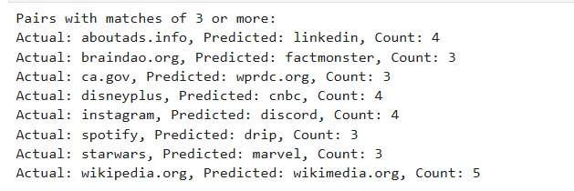
APP classification – previous attempts
5) Learning from confusion after first training what was misclassified and filtering those labels/classes and trying to learn only them and combine it with the first learning
Accuracy 72%

Slide 7
APP classification section – model building and training
To increase our dataset, we used SOMTE for trying and add more data.
We've selected 30 best features by select Kbest (throwing features according to correlation matrix with threshold of 0.95 and then selecting Kbest after it, gave the same accuracy)
For classification we used Bagging Classifier from Sklearn library
We used it with GridSearch for finding the best parameters that giving the highest accuracy
We got 78.5% of accuracy
By using Standard Scalar and searching for correct seed we raised it to 80.046% accuracy

Slide 8
Attribution classification section (VOD, file download, etc...)
Our way for the classification is based on a research of: G. Draper-Gil, A. H. Lashkari, M. S. I. Mamun, and A. A. Ghorbani,“Characterization of encrypted and VPN traffic using time-related features”
In this research they tried to do attribute classification by machine learning. They recommended to take time-based features.
This in addition to the Source ip, Source port, Destination ip, Destination port, Timestamp
We've took those feature and in addition we've looked on more researches that did attribution classification from the "vpn non-vpn ISCX 2016" dataset and tried to understand what the feature to use. most of them focused in the same features if we working with machine learning.

Slide 9
Attribution – feature selection
We’ve selected the feature manually from the dataset according to the article
From the article:
duration - The duration of the flow.
fiat - Forward Inter Arrival Time the time between two packets sent forward direction (mean, min, max, std).
biat - Backward Inter Arrival Time the time between two packets sent backwards (mean, min, max, std).
flowiat - Flow Inter Arrival Time the time between two packets sent in either direction (mean, min, max, std).
active - The amount of time time a flow was active before going idle (mean, min, max, std).
idle - The amount of time time a flow was idle before becoming active (mean, min, max, std).
fb psec - Flow Bytes per second.
fp psec - Flow packets per second.

Slide 10
Attribution – previous attempts
Adding statistical feature such as:
'packets_ratio', 'packets_length_ratio', 'total_packets', 'total_length', 'avg_packet_size', 'total_flags', 'timing_ratio', 'total_silence’, etc…
Throwing according to correlation matrix with threshold of 0.95
Selecting 30 best features by select K best
The accuracy was 80-84%

Slide 11
Attribution classification section – model training
After taking those features, we’ve dropped more features according to correlation matrix with threshold of 0.95
We’ve decided to train 3 different models each one with its own seed and objects input
1) Bagging Classifier
2) Random-Forest
3) Extra-Trees
All of them gave accuracy of 92%

Slide 12
Prediction on validation
After training the 3 models we’ve predict according to each one, the labels in the validation
For final prediction we’ve took the best of from the 3 from each classifier (In a case that each one classified the label different, we’ve took the bagging result).

Slide 13
Thanks! ☺

